Slide 1
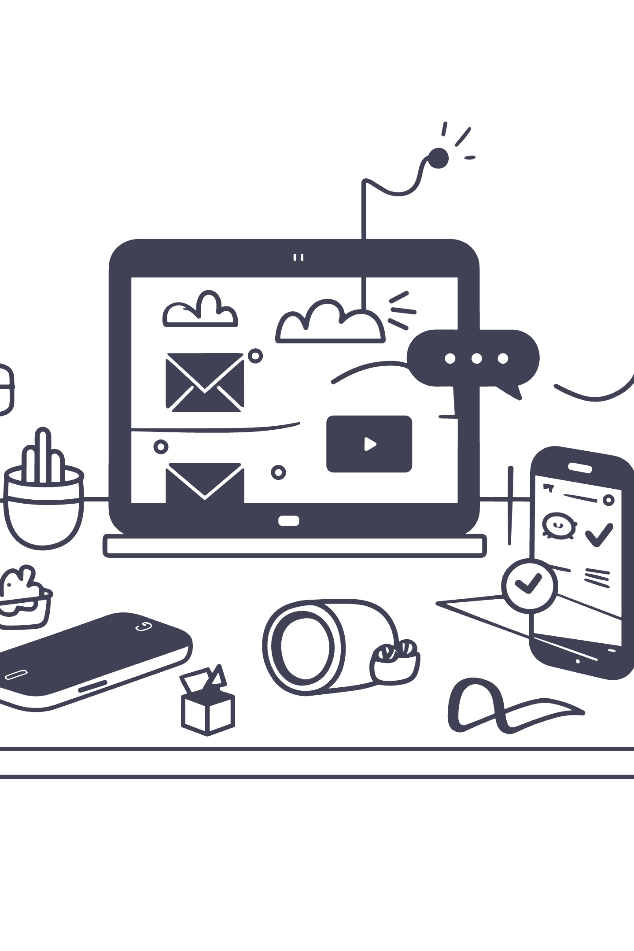
Step-by-Step Guide to Planning a Social Media Marketing Campaign
This guide outlines the essential steps for launching a successful social media campaign. From defining clear goals and identifying your audience to measuring results, you will learn how to drive meaningful engagement and achieve business objectives.

Slide 2
1. Define Your Goals
Be Specific
Be Measurable
Be Timebound
Avoid vague aims. Instead of "increase awareness," target "20% more brand mentions."
Use metrics like "50 qualified leads in 6 weeks" or "10% higher satisfaction scores."
Set deadlines, such as "grow Instagram followers by 500 in 2 months."

Slide 3

2. Identify Your Target Audience
Understanding who you are reaching is essential for creating resonant content. Build detailed buyer personas (e.g., "Sarah, 30, Marketing Pro") to visualize your ideal customer.
Key Factors
Demographics: Age, gender, location, income.
Interests: Hobbies, passions, and followed brands.
Behaviors: Online habits and purchasing patterns.
Pain Points: Challenges your product solves.

Slide 4

3. Choose the Right Platforms
Visual Focus
Professional
Instagram & Pinterest are ideal for showcasing products and building brand identity visually.
LinkedIn excels at B2B marketing, recruiting, and professional networking.
Real-Time
Viral Video
Twitter is best for news, conversations, and customer service.
TikTok offers short-form video entertainment, popular with Gen Z.

Slide 5
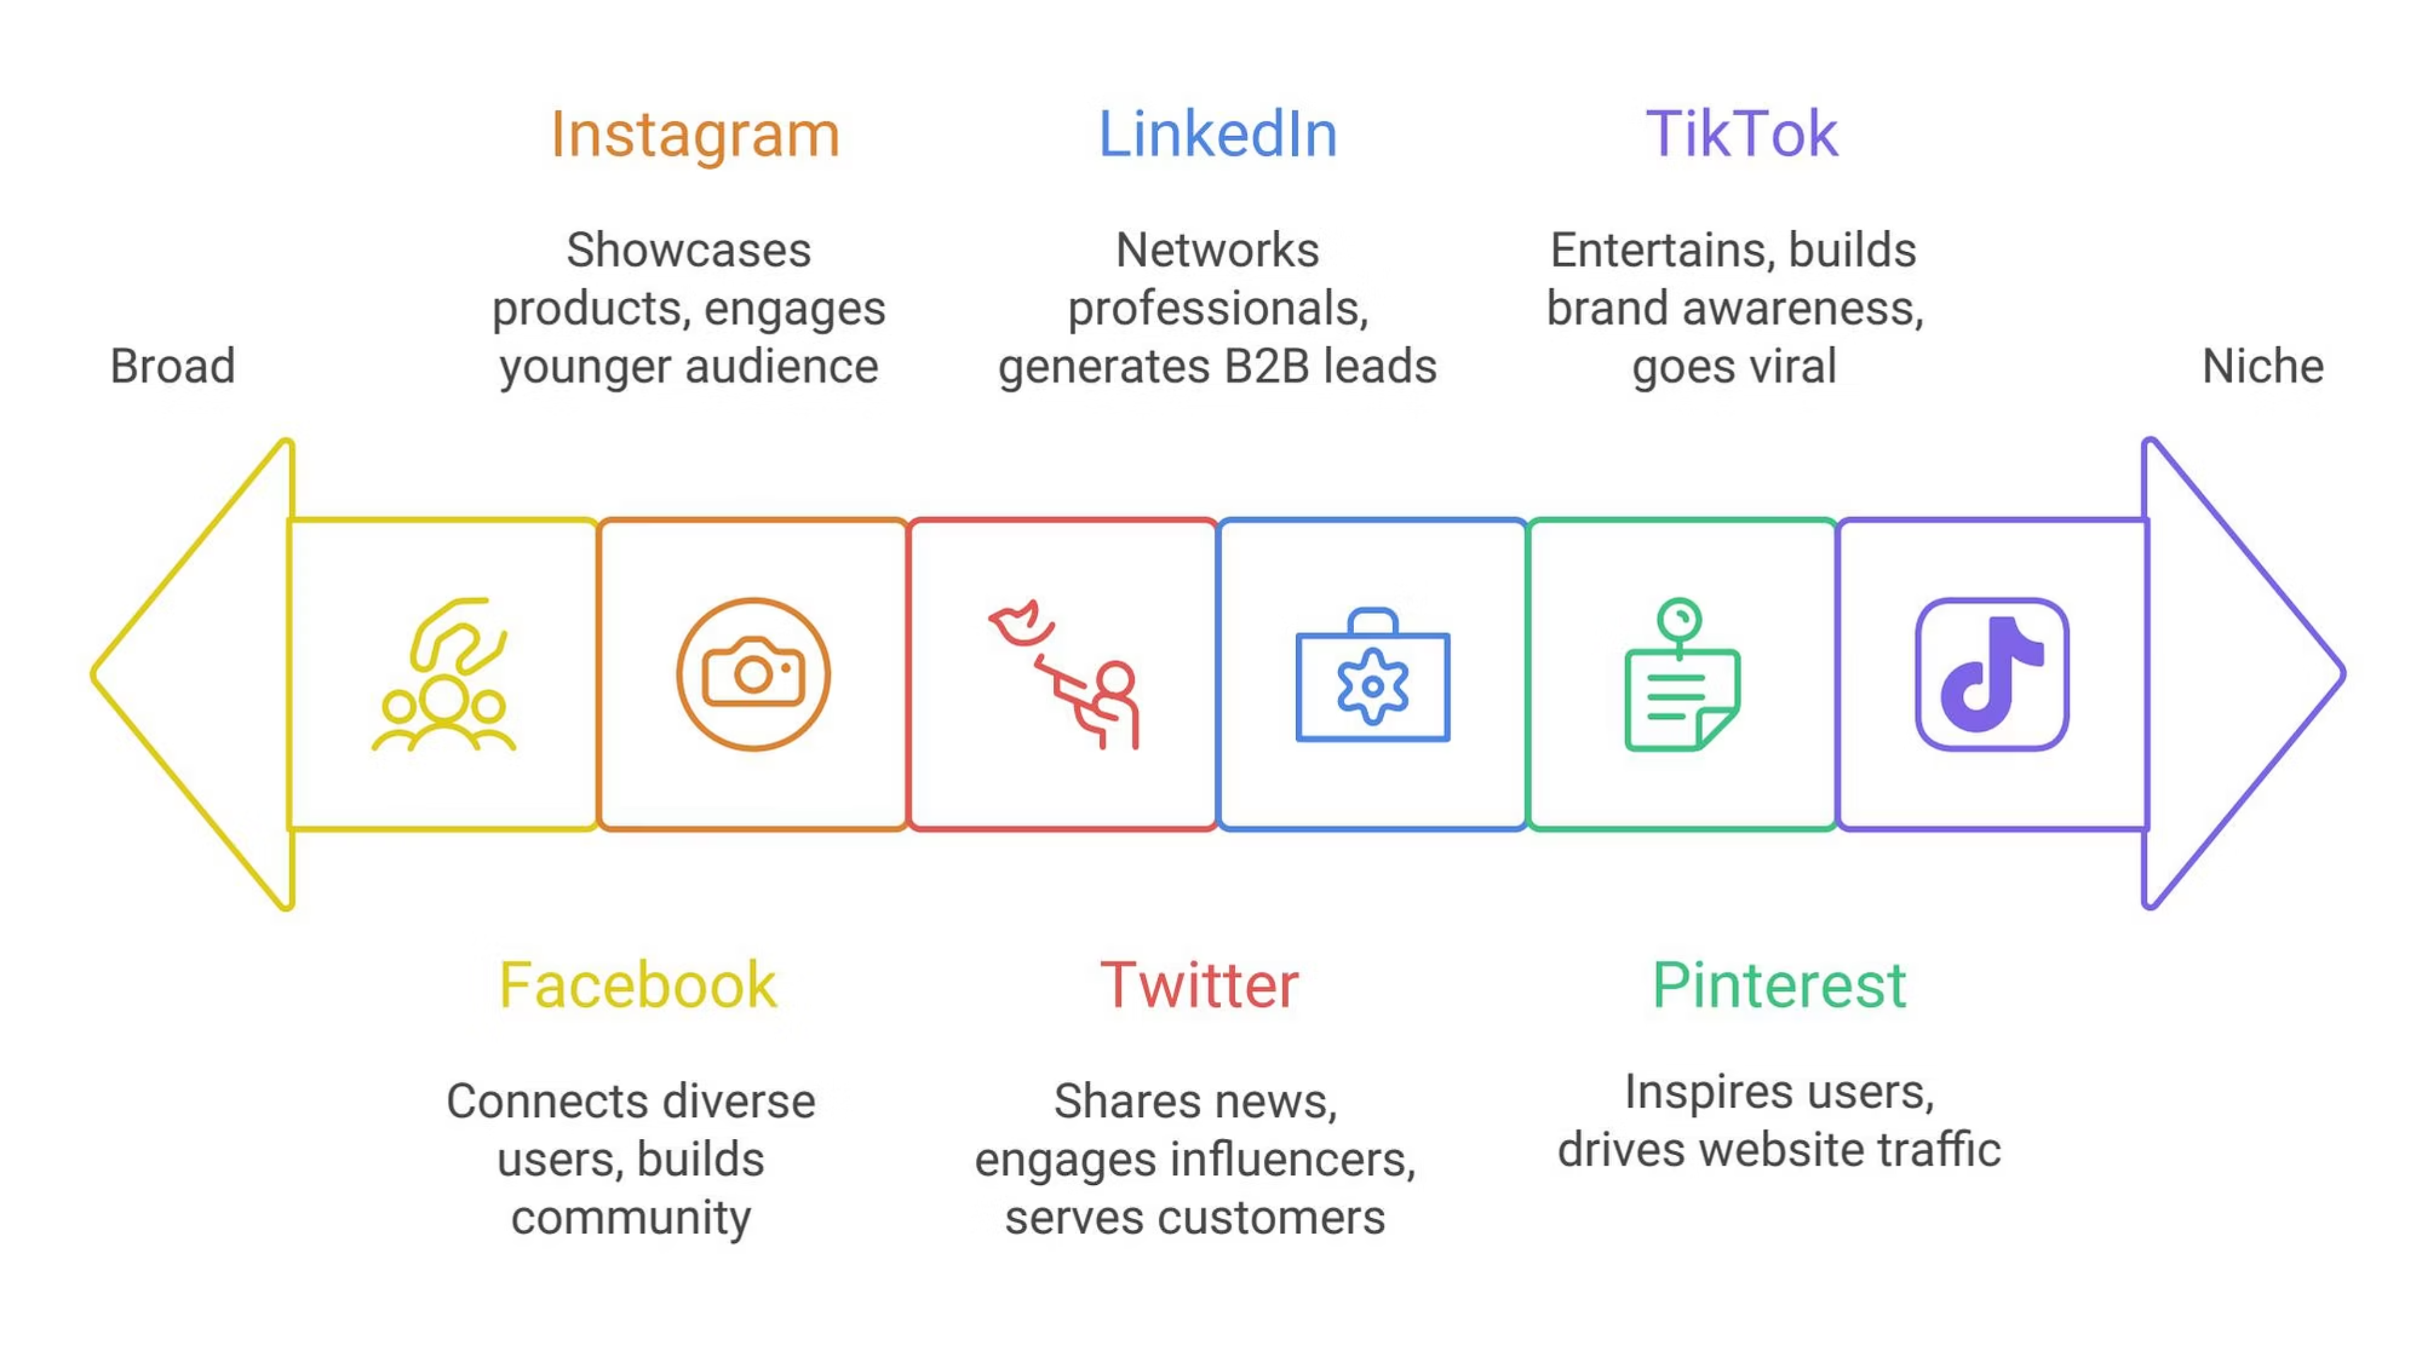

Slide 6
4. Develop Your Content Strategy
Align your content with campaign goals to ensure it is informative and engaging. Use a content calendar to stay organized and consistent.
Rich Media
Educational
Interactive
Use high-quality images, engaging videos, and stories for behind-the-scenes access.
Share blog posts with insights, tutorials, and infographics that simplify data.
Utilize live streams for real-time connection and encourage user-generated content.

Slide 7

5. Set a Budget
While organic reach is valuable, paid advertising maximizes impact. Allocate funds strategically across platforms like Facebook Ads Manager or LinkedIn Campaign Manager to target specific demographics.
Budget Considerations
Goals: How much are you willing to spend to achieve them?
Audience Costs: Price to reach users varies by platform.
Competition: Analyze competitor spending.

Slide 8
6. Implement Your Campaign
Engage Actively
Launch Ads
Don't just post—respond to comments and messages promptly. Active engagement builds community and trust.
Schedule Content
Activate your paid campaigns across your chosen platforms to reach your targeted demographics effectively.
Use management tools like Hootsuite or Buffer to organize and automate posts, saving time and ensuring consistency.

Slide 9
7. Monitor and Measure Results
Tracking performance is vital. Use analytics tools to gain insights into your audience and content effectiveness.
Traffic
Leads
Engage
Website Visits
Conversion
Interaction
Monitor referrals from social channels.
Track qualified leads generated.
Measure likes, shares, and comments.

Slide 10

8. Analyze and Optimize
Continuous Improvement
Social media marketing is an ongoing process. Analyze what works and adjust your strategy to maximize ROI.
Identify Trends: See what content types perform best.
Experiment: Try different posting times or targeting options if engagement lags.
Adapt: Stay flexible with changing algorithms.

